Slide 1
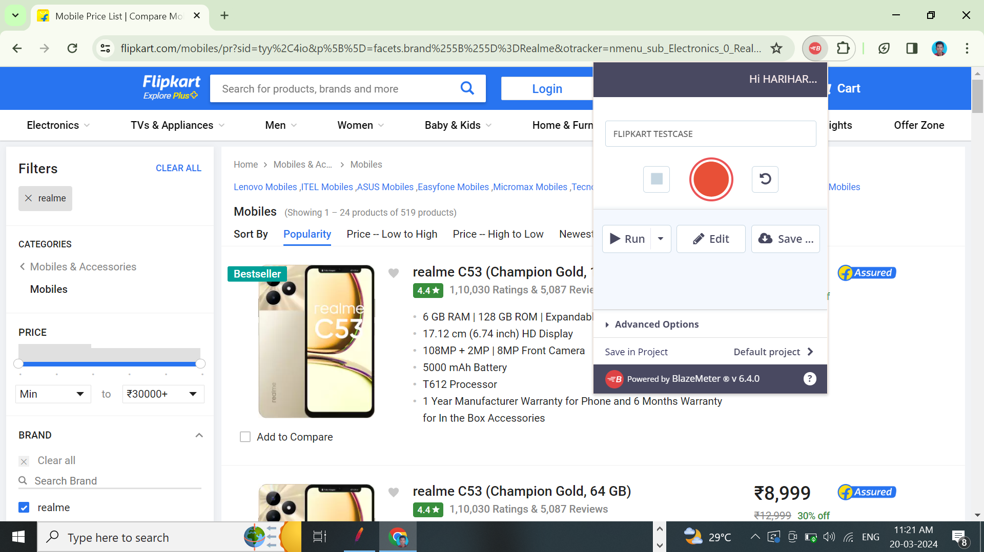
ASSIGNMENT - 9
STEP 1 : USE FLIPKART.COM

Slide 2
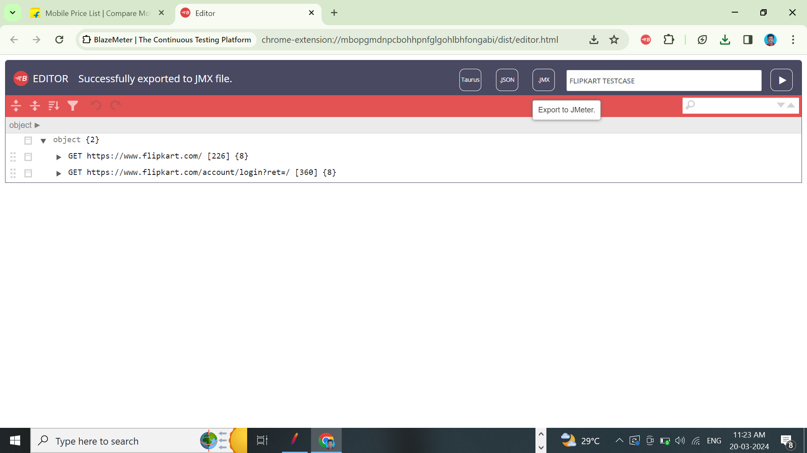
STEP 2 : CREATE A JMX FILE USING BLAZEMETE.
STEP 3 : EXPORT THE FILE.

Slide 3
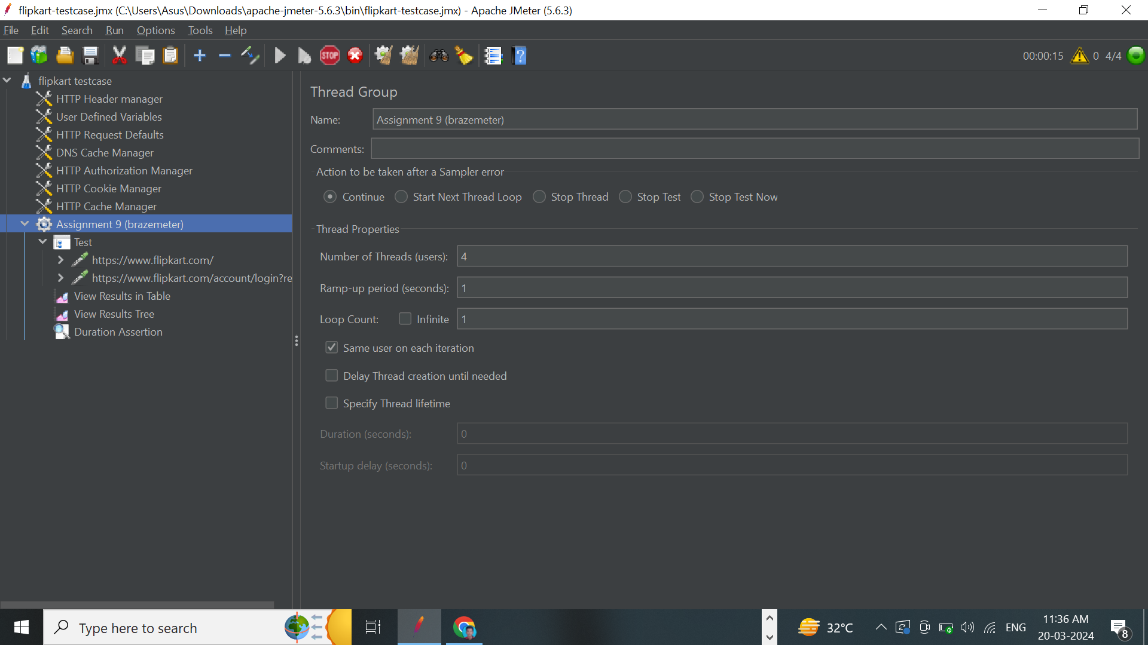
STEP 4 : IMPORT THAT INTO JMETER

Slide 4
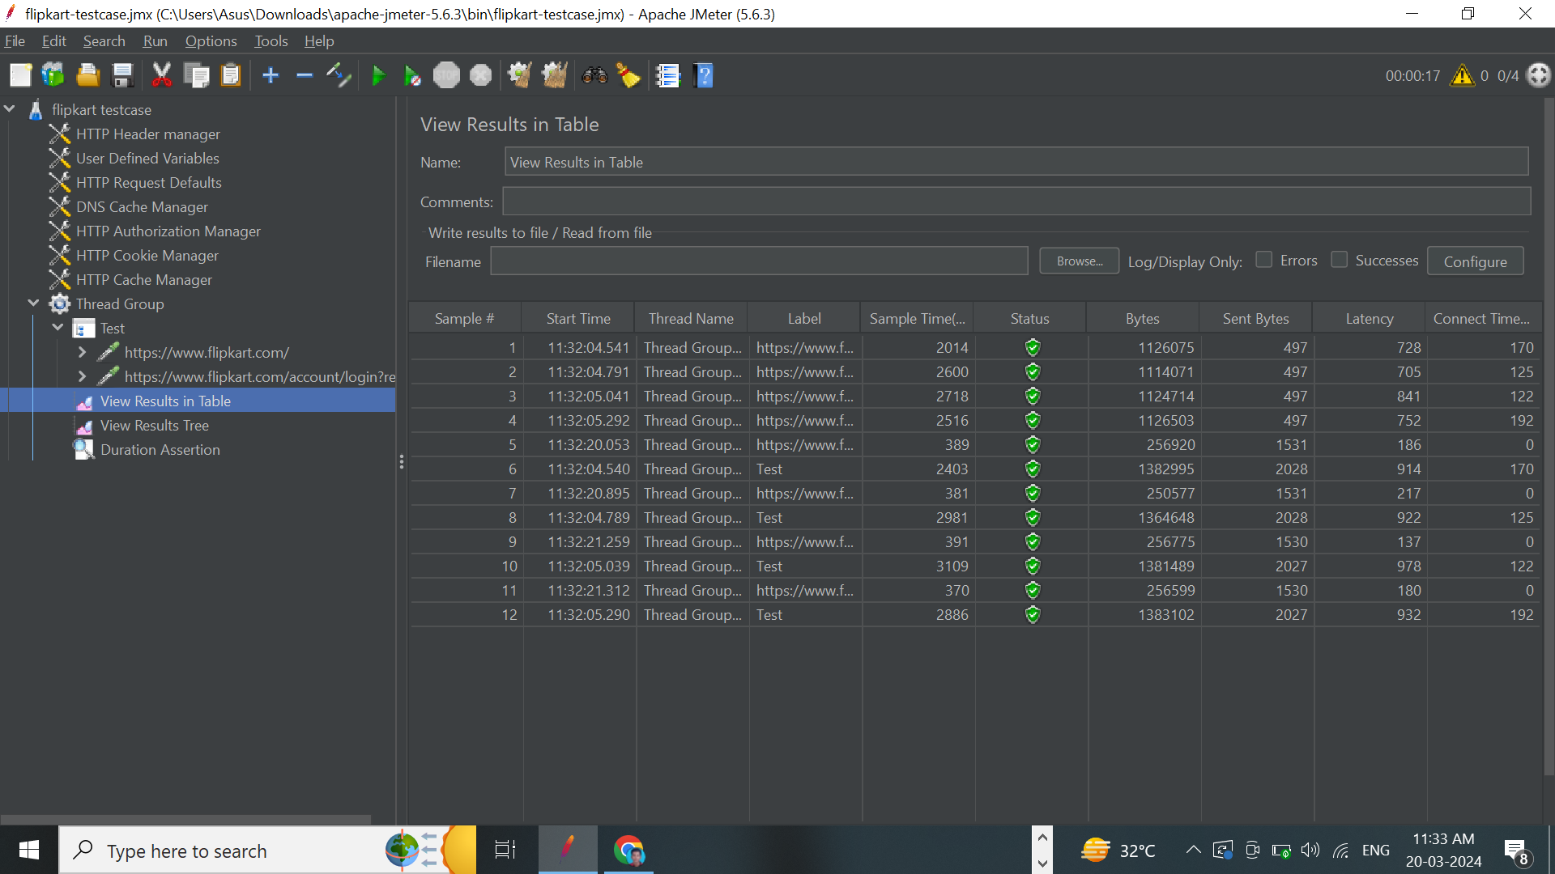
STEP 5 : CHECK LISTENERS TABLE .

Slide 5
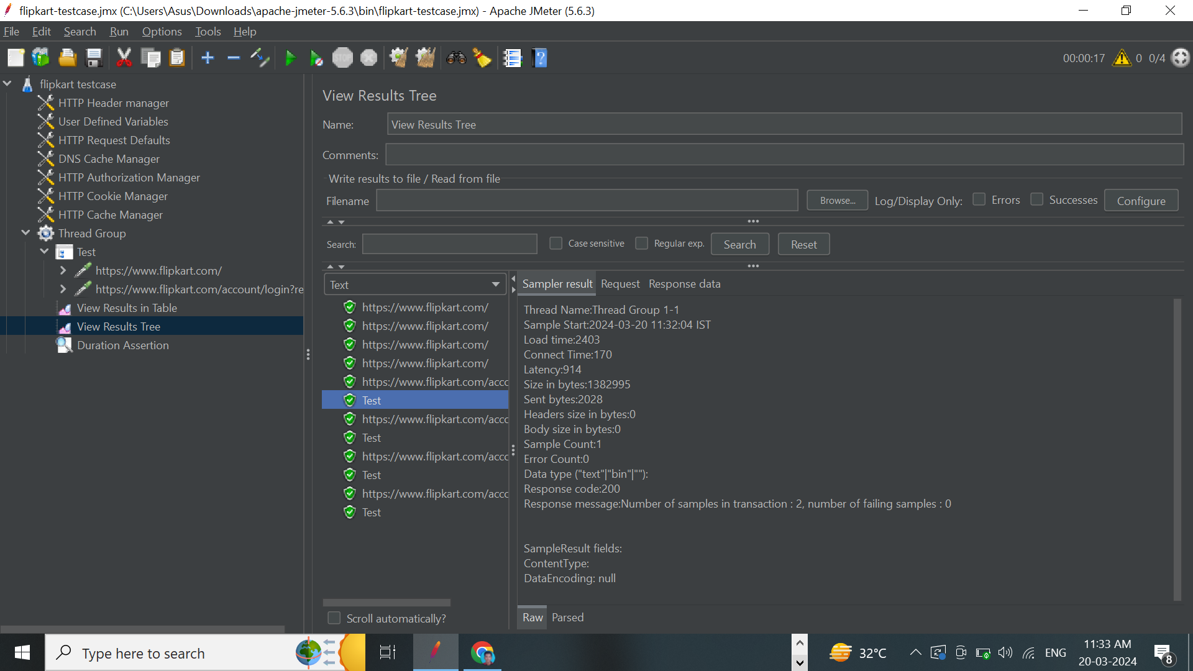
STEP 6 : CHECK VIEW RESULTS TREE

Slide 6
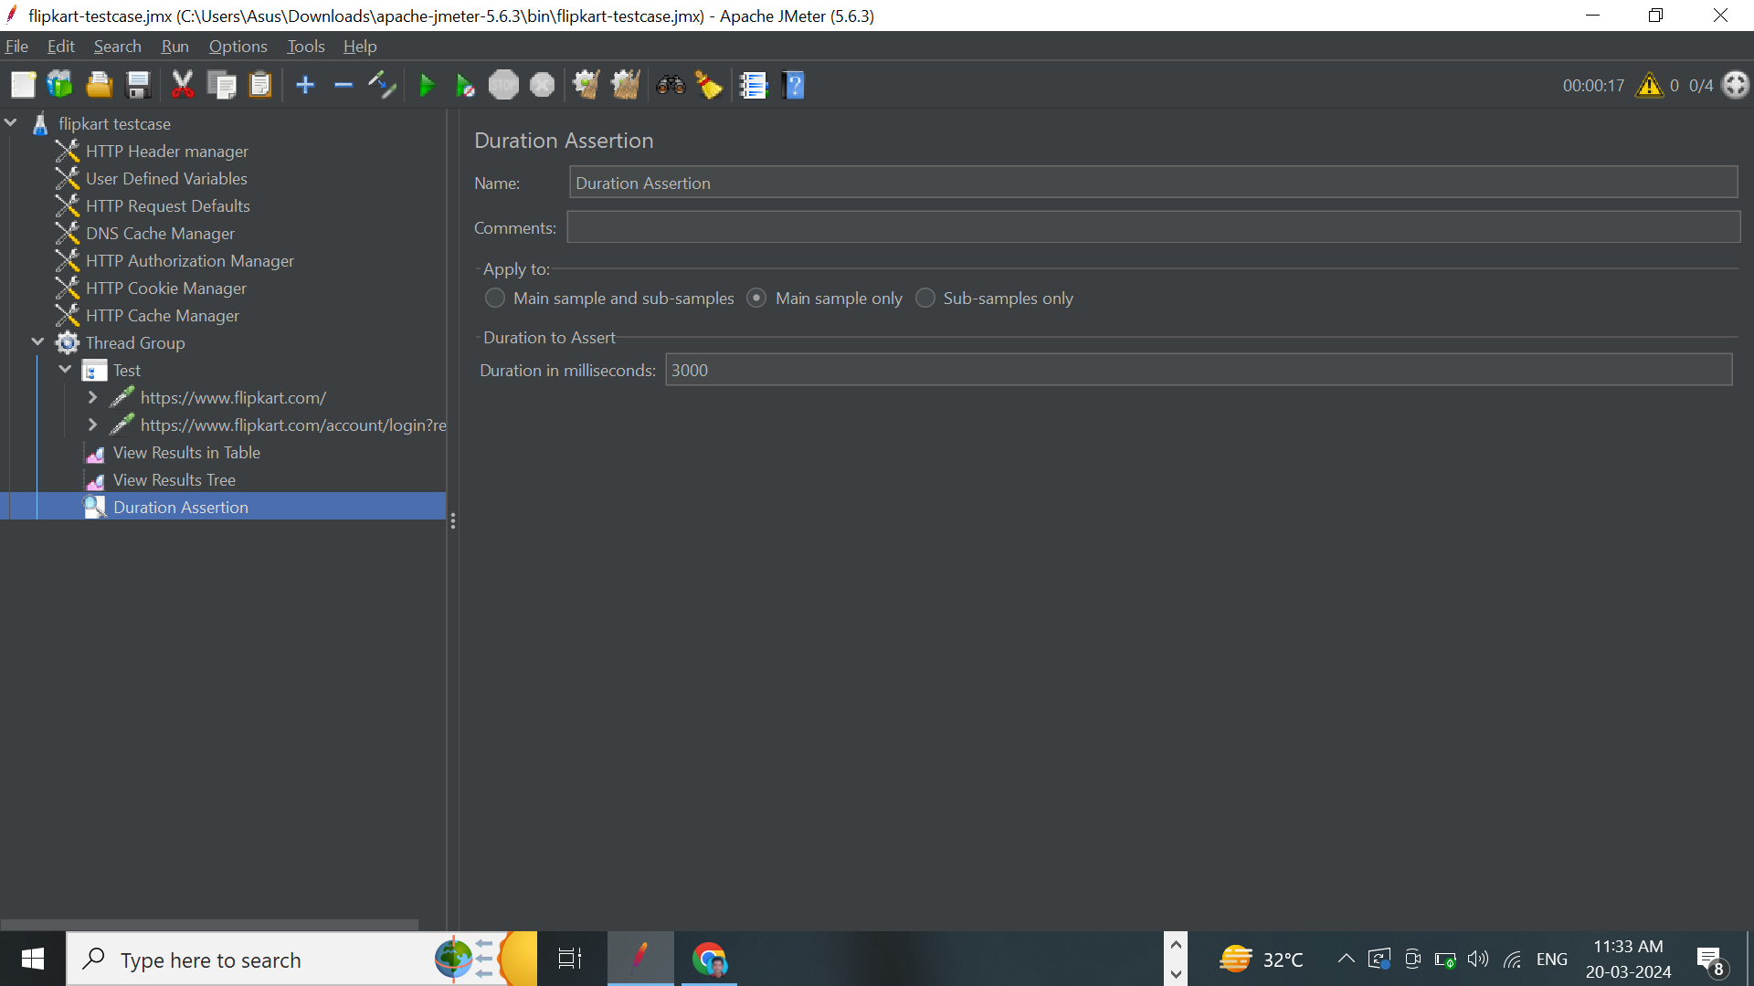
STEP 7 : ADD ASSERTION RESPONSE TIME, DURATION
STEP 8 : SAVE THE JMETER FILE AND EXECUTE THE FILE

